Slide 1
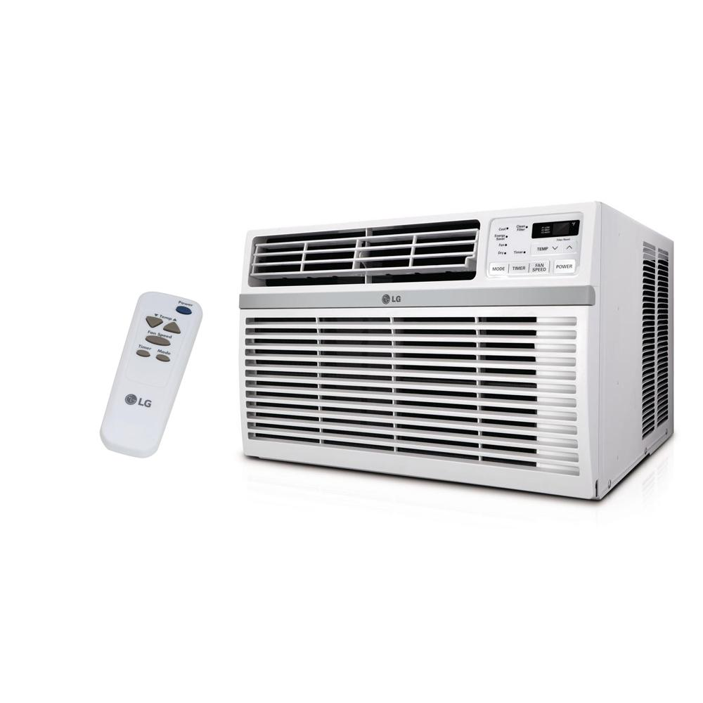
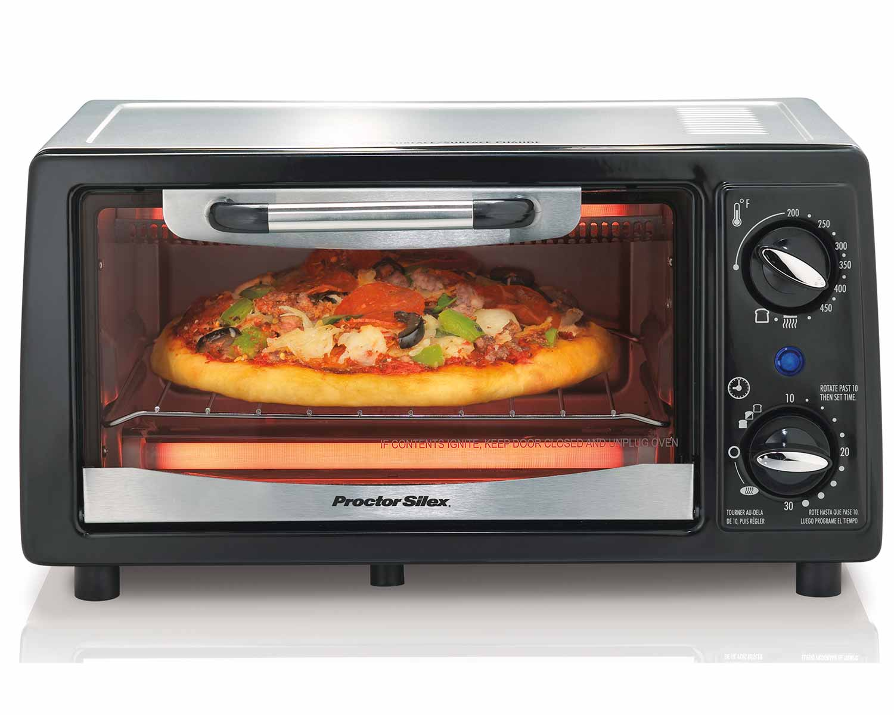
Looping / Iteration
Repeating a set of instruction for a period of time
Notes:
Title + Image + Text

Slide 2

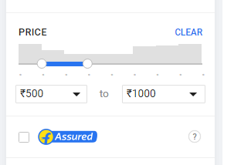

Looping / Iteration
How will you write this in programming?
Notes:
Title + Image + Text

Slide 3
Looping / Iteration
(price >= 500 && Price <= 1000)
{
display the bag;
}
repeat if
while(price >= 500 && price <= 1000)
{
display the bag;
}
In programming, sometimes we need to execute a block of code multiple times.
Loops are used to repeatedly execute a block of statements.
Notes:
Title + Image + Text

Slide 4
Types of Loops/ Control Statements
while
for
do - while
- Entry check loop
- The condition will be checked
first
- Exit check loop
- The statements will be
executed first

Slide 5
Looping / Iteration
Why are we using three loops?
Know the number of iteration - for
Don’t know the number of iteration - while
Statement to be executed atleast once – do - while

Slide 6
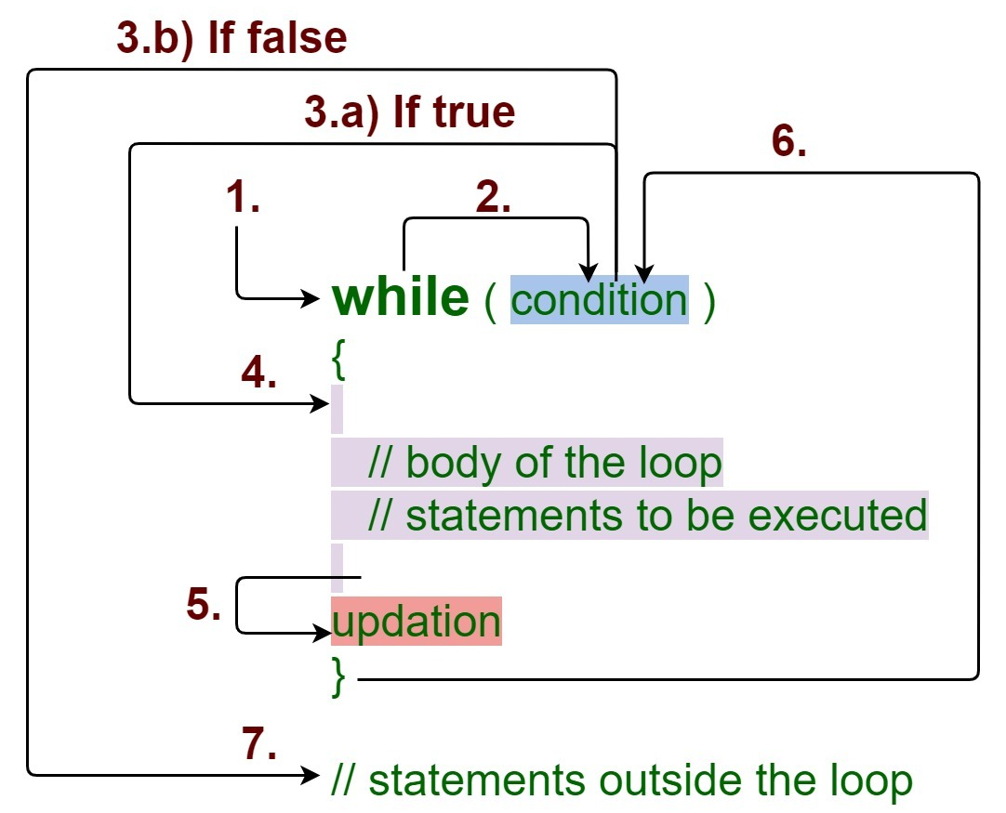
while Loop
The while loop loops through a block of code as long as a specified condition is true.
Syntax:
while (condition)
{
// code block to be executed
//increment or decrement
}

Slide 7
while Loop
int i=1;
while (i<=10)
{
pritnt(“Hello\n”);
i++;
}
How while loop works?
While loop evaluates the testExpression(condition) inside the parentheses ().
If testExpression is true, statements inside the body of while loop are executed. then, testExpression is evaluated again.
The process goes on until testExpression is evaluated to false.
If testExpression is false, the loop terminates (ends).

Slide 8
Loops/Control Statements
Write a C program to print all natural numbers from 1 to n using loop.
Print 1 to N
Sample Input:
Sample Output:
10
1 2 3 4 5 6 7 8 9 10

Slide 9
Code
1
2
3
4
5
6
7
8
9
10
11
12
13
14
#include<stdio.h>
int main()
{
int n;
scanf(“%d”, &n);
How…??
int number = 1;
while(number <= n){
printf(“%d”, number);
number++;
}
return 0;
}

Slide 10
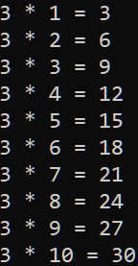
while Loop
Write a C program to read an integer and print its multiplication table
Logic:
Read an integer number
Take a loop counter and initialize it with 1
Run a loop from 1 to 10
Print the multiplication of input number and loop counter
Increase the loop counter

Slide 11
while Loop
C program to print EVEN numbers from 1 to N using while loop.
Example:
Input:
Enter value of N: 10
Output:
Even Numbers from 1 to 10:
2 4 6 8 10
Logic:
checking the condition number<=n
within the loop, we are checking the condition to check whether number is EVEN or not
(number%2==0)

Slide 12
while Loop
#include<stdio.h>
int main()
{
int number;
int n;
number=1;
printf("Enter the value of N: ");
scanf("%d",&n);
printf("Even Numbers from 1 to %d:\n",n);
while(number<=n)
{
//Here is the condition to check EVEN number
if(number%2==0)
printf("%d ",number);
// increasing loop counter by 1
number++;
}
return 0;
}

Slide 13
while Loop
Write a C program to find Sum of digits of a given number using while.
LOGIC
Step 1: Get number by user
Step 2: Ger remainder of the number
Step 3: Sum the remainder of the number
Step 4: Divide the number by 10
Step 5: Repeat the step 2 while number is greater than 0.
Example:
Enter a number:654
Sum is=15
Enter a number:123
Sum is=6

Slide 14
while Loop
#include<stdio.h>
int main()
{
int n, sum=0,rem;
printf("Enter a number:");
scanf("%d",&n);
while(n!=0)
{
rem=n%10;
sum=sum+rem;
n=n/10;
}
printf("Sum is=%d",sum);
return 0;
}

Slide 15
while Loop
Write a C Program to find the reverse of a given number
Enter any n.
Declare rev=0, where rev an integer variable.
Get rem(last_digit) of n by performing the modulo division (%) and store the value in rem(last_digit) variable, likey rem= n % 10.
Multiply rev by 10 and add rem(last_digit), like rev = rev*10 + rem.
Divide n by 10, like n/10.
Repeat the steps 3 to 5 till numbered is not equal to (or greater than) zero.
Example:
Enter a number: 123
Reversed Number: 321

Slide 16
while Loop
//Program to find the reverse of a given number
#include<stdio.h>
int main()
{
int n, reverse=0, rem;
printf("Enter a number: ");
scanf("%d", &n);
while(n!=0)
{
rem=n%10;
reverse=reverse*10+rem;
n/=10;
}
printf("Reversed Number: %d", reverse);
return 0;
}

Slide 17
while Loop
Write a C program to find the given number is Armstrong Number or not
Armstrong number is a number that is equal to the sum of cubes of its digits.
For example 0, 1, 153, 370, 371 and 407 are the Armstrong numbers.
Let's try to understand why 153 is an Armstrong number.
153 = (1*1*1)+(5*5*5)+(3*3*3)
where:
(1*1*1)=1
(5*5*5)=125
(3*3*3)=27
So:
1+125+27=153
enter the number=153
armstrong number
enter the number=5
not armstrong numbe

Slide 18
while Loop
#include<stdio.h>
int main()
{
int n,r,sum=0,temp;
printf("enter the number=");
scanf("%d",&n);
temp=n;
while(n>0)
{
r=n%10;
sum=sum+(r*r*r);
n=n/10;
}
if(temp==sum)
printf("armstrong number ");
else
printf("not armstrong number");
return 0;
}

Slide 19
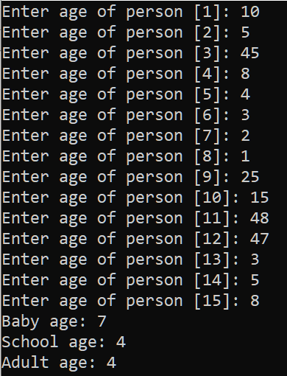
while Loop
Write a C program to read age of 15 persons and count total Baby age, School age and Adult age
Question
WAP to read an age of 15 person & find out how many of them fall under : a) Still a baby- age 0 to 5 b) Attending school - age 6 to 17 c) Adult life-age 18 & over [using while loop]

Slide 20
#include <stdio.h>
int main()
{
int age;
int cnt_baby=0,cnt_school=0,cnt_adult=0;
int count=0;
while(count<15)
{
printf("Enter age of person [%d]: ",count+1);
scanf("%d",&age);
if(age>=0 && age<=5)
cnt_baby++;
else if(age>=6 && age<=17)
cnt_school++;
else
cnt_adult++;
//increase counter
count++;
}
printf("Baby age: %d\n",cnt_baby);
printf("School age: %d\n",cnt_school);
printf("Adult age: %d\n",cnt_adult);
return 0;
}

Slide 21
for Loop
Syntax:
for (statement 1; statement 2; statement 3)
{
// code block to be executed;
}
Statement 1 is executed (one time) before the execution of the code block. It is an initialization statement.
Statement 2 defines the condition for executing the code block. It is a conditional statement.
Statement 3 is executed (every time) after the code block has been executed. It is a updating statement.

Slide 22
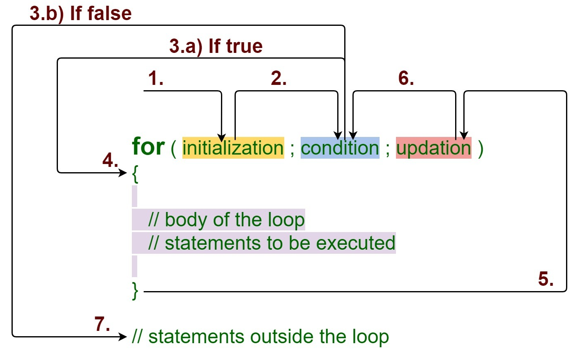
for Loop

Slide 23
Loops/Control Statements
Write a C program to print all natural numbers from 1 to n using for -loop.
Print 1 to N
Sample Input:
Sample Output:
10
1 2 3 4 5 6 7 8 9 10

Slide 24
Code
1
2
3
4
5
6
7
8
9
10
11
12
13
14
#include<stdio.h>
int main()
{
int n;
scanf(“%d”, &n);
for(int i=1; i<=n; i++){
printf(“%d”, i);
}
return 0;
}

Slide 25
Write a C program to calculate sum of first N natural numbers.
Output:
RUN 1:
Enter the value of N: 100
Sum is: 5050
RUN 2:
Enter the value of N: 10
Sum is: 55
RUn 3:
Enter the value of N: 3
Sum is: 6
LOGIC
read the value of N
Declare and initialize sum=0;
Loop through sum=sum+I;

Slide 26
Write a C program to calculate sum of first N natural numbers.
/*C program to calculate sum of first N natural numbers.*/
#include <stdio.h>
int main()
{
int n, i;
int sum;
printf("Enter the value of N: ");
scanf("%d", &n);
sum = 0;
for (i = 1; i <= n; i++)
sum += i;
printf("Sum is: %d\n", sum);
return 0;
}

Slide 27
Write a C Program To print Odd Numbers between 1 To n using for -loop
OUTPUT:
Enter how many number you want
10
Odd Numbers Between 1 to 10 :
1
3
5
7
9
Logic:
Read n
Declare and Initialize number=1
checking the condition number<=n
within the loop, to check whether number is EVEN or not
(number%2!=0)

Slide 28
//C Program To Print Odd Numbers Between 1 To N using for-loop
//C Program To Print Odd Numbers Between 1 To N
#include<stdio.h>
void main()
{
int i,n;
printf("Enter how many number you want \n");
scanf("%d",&n);
printf("Odd Numbers Between 1 to %d : \n",n);
for(i=1;i<=n;i++)
{
if(i%2!=0)
{
printf("%d \t",i);
}
}
}

Slide 29
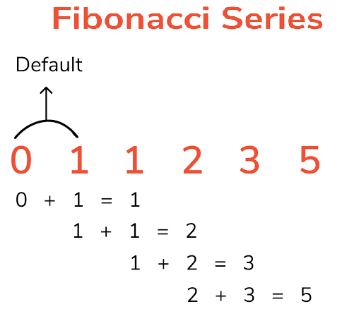
Write a C Program to print Fibonacci series up to n using for loop
The sequence is a Fibonacci series is the sum of the previous two numbers.
The first two terms of the Fibonacci sequence is started from 0, 1.
In mathematical terms :F_{n} = F_{n-1} + F_{n-2} Where, F₀ : 0 F₁ : 1
Output:
Enter the number of elements: 10
0 1 1 2 3 5 8 13 21 34

Slide 30
Write a C Program to print Fibonacci series up to n using for-loop
#include<stdio.h>
int main()
{
int n1=0,n2=1,n3,i,number;
printf("Enter the number of elements:");
scanf("%d",&number);
printf("\n%d \t %d\t ",n1,n2);//printing 0 and 1
for(i=2;i<number;++i) //loop starts from 2 because 0 and 1 are already printed
{
n3=n1+n2;
printf(" %d\t",n3);
n1=n2;
n2=n3;
}
return 0;
}

Slide 31
Write a C Program to print Factorial of a given number using for -loop
Factorial of n is the product of all positive descending integers.
Factorial of n is denoted by n!.
For example:
5! = 5*4*3*2*1 = 120
3! = 3*2*1 = 6
Output:
Enter a number: 5
Factorial of 5 is: 120

Slide 32
Write a C Program to print factorial of n using for-loop
#include<stdio.h>
int main()
{
int i,fact=1,number;
printf("Enter a number: ");
scanf("%d",&number);
for(i=1;i<=number;i++)
{
fact=fact*i;
}
printf("Factorial of %d is: %d",number,fact);
return 0;
}

Slide 33
do-while Loop

Slide 34
Write a C Program to count the number of digits in a given number.
Count the number of digits
Sample Input:
Sample Output:
44
2

Slide 35
Write a C Program to count the number of digits in a given number.
Pseudocode
input: n
count = 0
while (n > 0)
{
count++
n = n / 10
}
print count
Sample Input :
0
Output : ???
Notes:
Here the output is 0. But expected output is 1. Try to rewrite the code

Slide 36
Write a C Program to count the number of digits digits in a given number.
Pseudocode
input: n
count = 0;
if(n == 0){
print “1”
}
else{
while(n > 0)
{
count++
n = n / 10
}
print count
}
without “if” , how will you write this program?
Notes:
Here the output is 0. But expected output is 1. Try to rewrite the code

Slide 37
Using do- while
Pseudocode
input: n
count = 0;
if(n == 0){
print “1”
}
else{
while (n > 0)
{
count++
n = n / 10
}
print count
}
input: n
do{
count++
n = n / 10
}while(n > 0)
Notes:
Here the output is 0. But expected output is 1. Try to rewrite the code

Slide 38
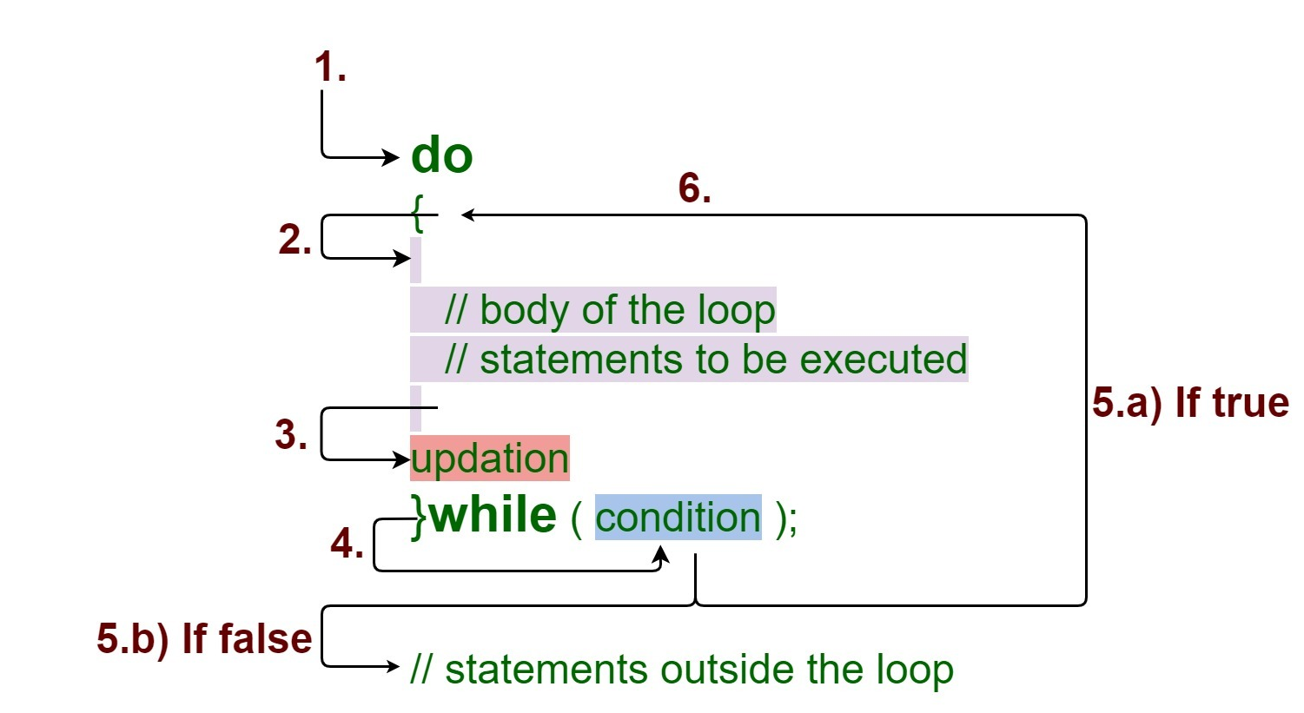
do-while Loop
The do while loop is a post tested loop.
The do-while loop is mainly used in the case where we need to execute the loop at least once before checking condition
syntax:
do{
//code to be executed
}while(condition)

Slide 39
Code
#include<stdio.h>
int main()
{
int n;
scanf(“%d”, &n);
int count = 0;
do{
count++;
n = n / 10;
}while(n > 0);
printf(“%d”, count);
}

Slide 40
Write a C Program to display MENU using do.. while and perform an arithmetic operation using switch.
Output
n1=5, n2=10 === Menu === 1. Addition 2. Substruction 3. Exit Enter your choice:1 The addition = 15
Notes:
We will see return in later lesson

Slide 41
#include<stdio.h> int main() { int choice, n1=5, n2=10; printf("n1=5, n2=10 \n"); do { printf("=== Menu ===\n"); printf("1. Addition\n"); printf("2. Substraction\n"); printf("3. Exit\n"); printf("Enter your choice:"); scanf("%d",&choice); switch (choice) { case 1: printf("The addition = %d \n", n1 + n2); break; case 2: printf("The substraction = %d \n", n1 - n2); break; case 3: printf("Goodbye\n"); break; default: printf("Wrong Choice. Enter again\n"); break; } } while (choice != 3); return 0; }
Notes:
We will see return in later lesson

